Slide 1
Event Planner
Group 6
Nehesia Edmond
Eric Osuala
James Helm

Slide 2
Problem Statement
Many students’ school lives are incredibly busy. In addition to balancing several courses and their workloads, they must also balance social obligations while still being able to pay their mounting bills.
Due to these competing responsibilities, many things can slip through the cracks. The further students progress in their education the less time they must manage their obligations.
Consider that around forty percent of all college students work thirty hours a week, and a quarter hold full-time jobs while being full-time students. Twenty-two percent of students are also parents.

Slide 3
Our Solution
With these concerns in mind, we note that if students were able to organize their required tasks in a centralized location, it may prove very beneficial.
Providing such capabilities could promote improved organizational skills, strong time management, and improved grades.
Thus, we have opted to create an Event Planner.

Slide 4

How Our Application Works
Our Application serves as a “One Stop Shop” for the most common needs for students. Students will have the ability to:
Check and add tasks on a weekly and monthly basis
Access the University’s bookstore
Access the University’s email
Access a centralized location for study resources
Use various destressing techniques

Slide 5
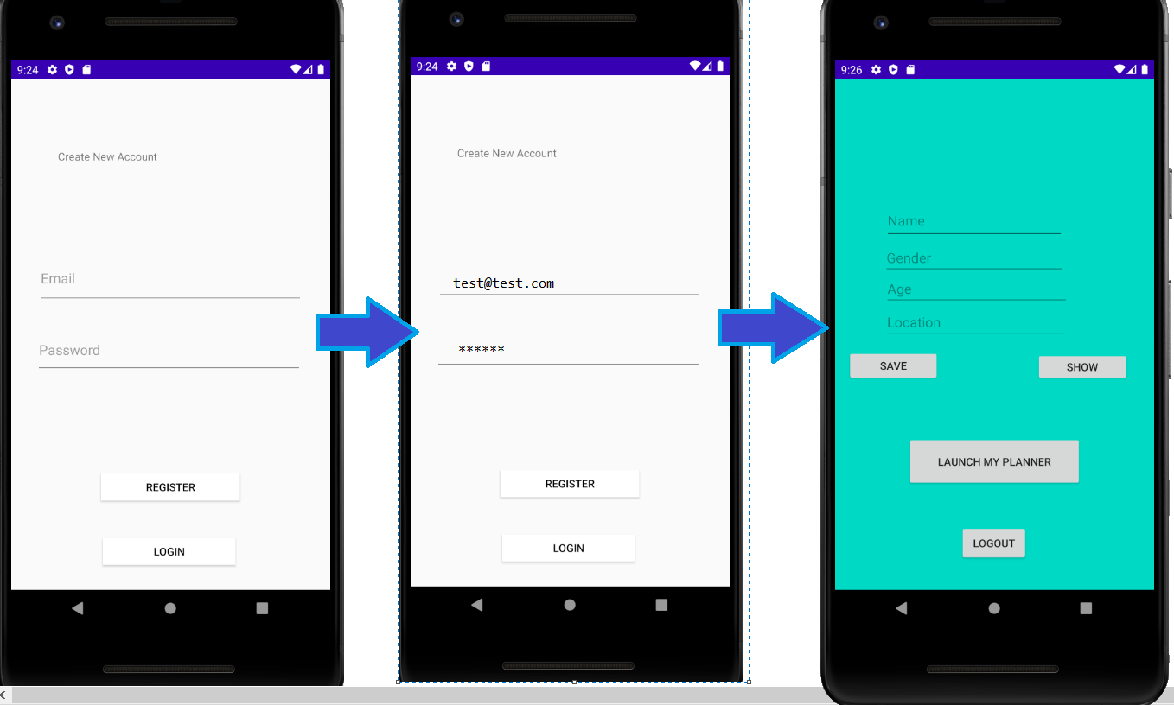
Registration
Our application begins on the LogIn page. The user has the option of registering if they do not have an account or loggin in if they do. The app will then request that they provide information before launching. The requested information is not required and the user may continue without it.

Slide 6
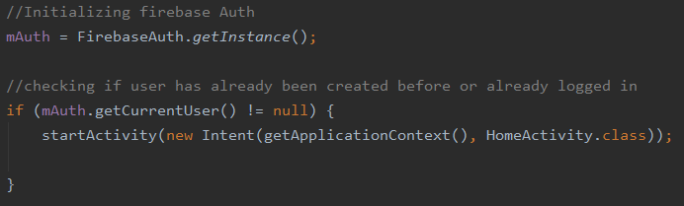
Primary Concepts Used
Firebase was used to store the user’s log in, name, age, gender, and location.
This was used for initialization.

Slide 7
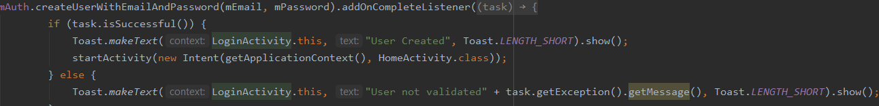
Primary Concepts Used Cont.
Using the object initilizsed, we would be able to create the user’s account with addresses and passwords. It can also be used to manage the app's password-based accounts.

Slide 8
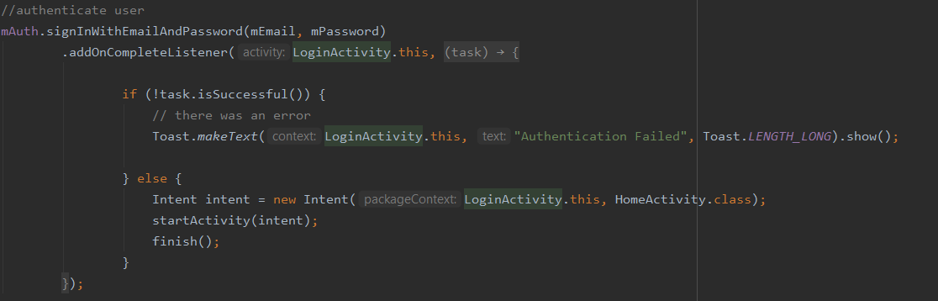
Primary Concepts Used Cont.
Using the firebase object, we can authenticate the user’s email and password for management in our app.
This was used to authenticate the user’s account.

Slide 9
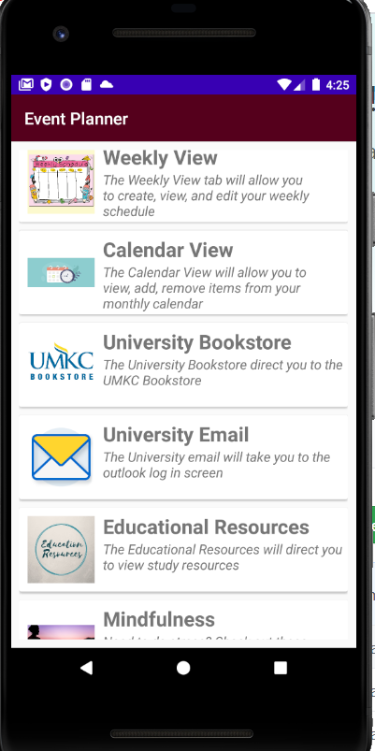
Main Screen
Once the user has logged in, they are shown a page with a list of choices to select from:
Weekly
Calendar
University Bookstore
University Email
Educational Resources
Mindfulness
Entertainment

Slide 10
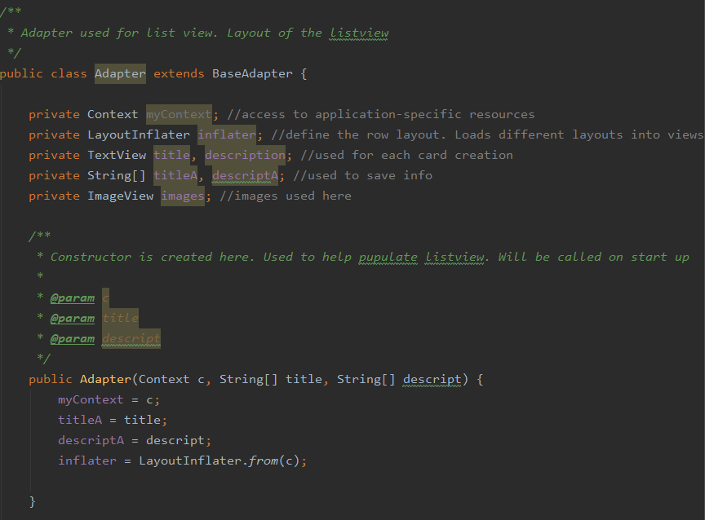
Primary Concepts Used
An Adapter was used to act as a ‘bridge’ between the Adapter and the data it wishes to access. This was used to help create the layout for the list view.

Slide 11
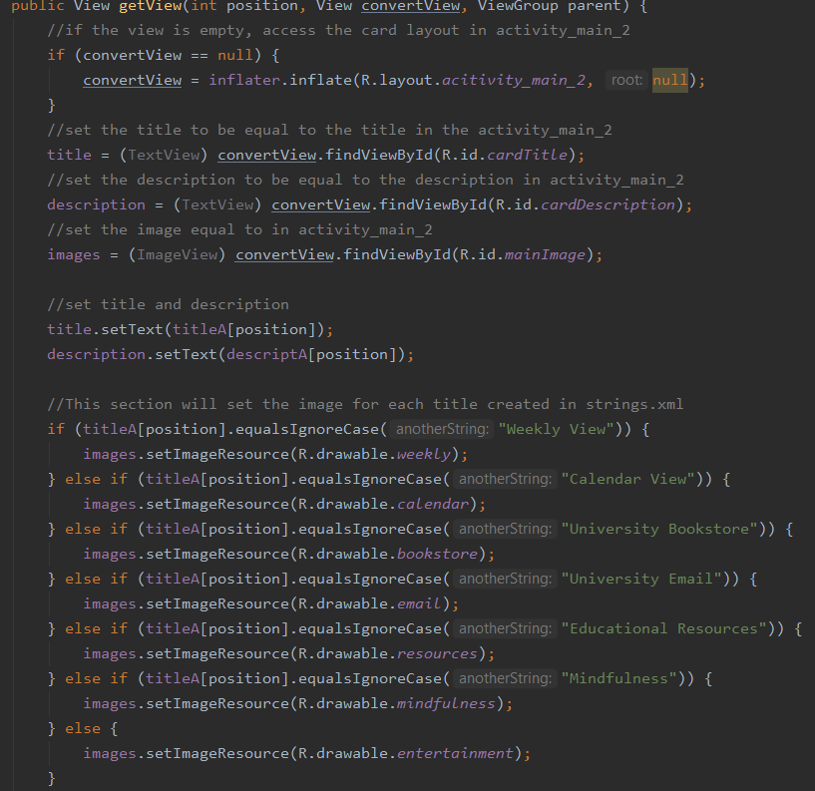
Primary Concepts Used Cont.
A function was then created to help create the view. Conditional statements are used to help set the correct text, description, and image.

Slide 12
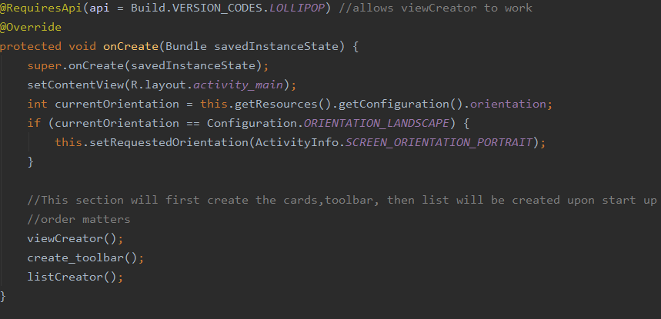
Primary Concepts Used Cont.
Sets the phones orientation then, upon start up, will create the UI the user will see.

Slide 13
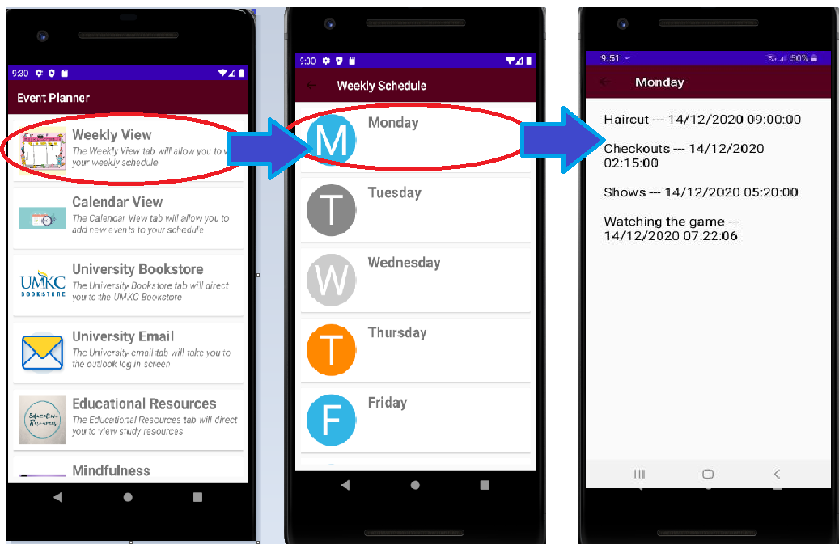
Weekly View Tab
The weekly tab will allow the user to select a desired day of the week (Mon-Sunday). Once they have made their selection, it will direct them to the list of tasks they have to complete for the day.

Slide 14
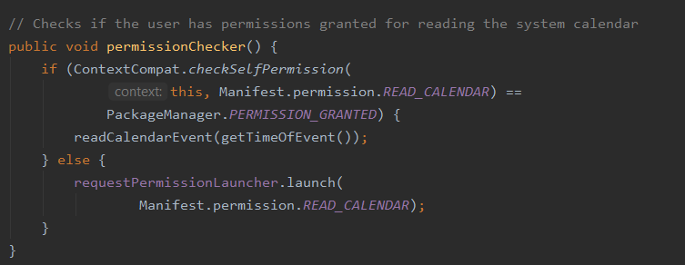
Primary Concepts Used
This will check that permissions are given for using the device’s calendar. It will request permission if not already given.

Slide 15
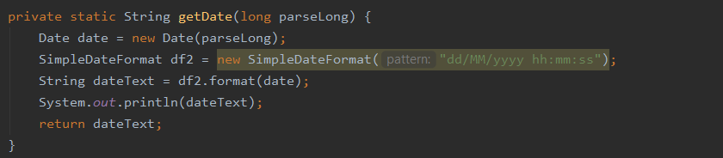
Primary Concepts Used Cont.
This getter will retrieve the date for future use and format it as needed.

Slide 16
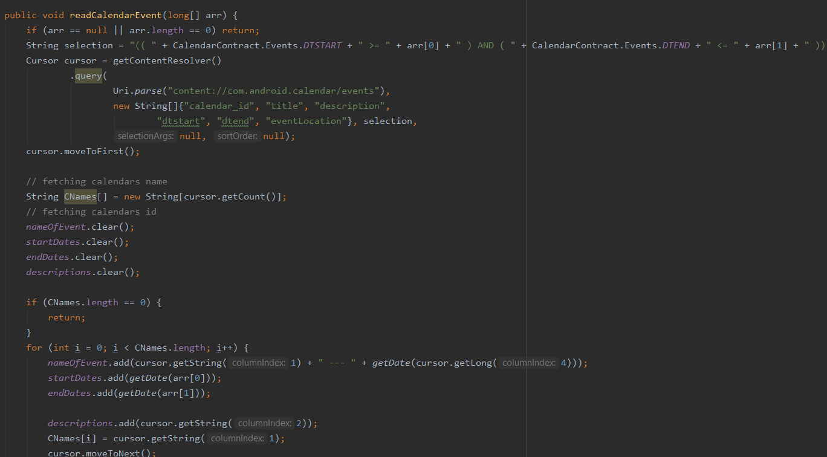
Primary Concepts Used Cont.
This function will read the events from the calendar on the device. It will then
CalendarContract.Events.DTSTART is used to access the events for a specific day. It is used for the Individual Day class.

Slide 17
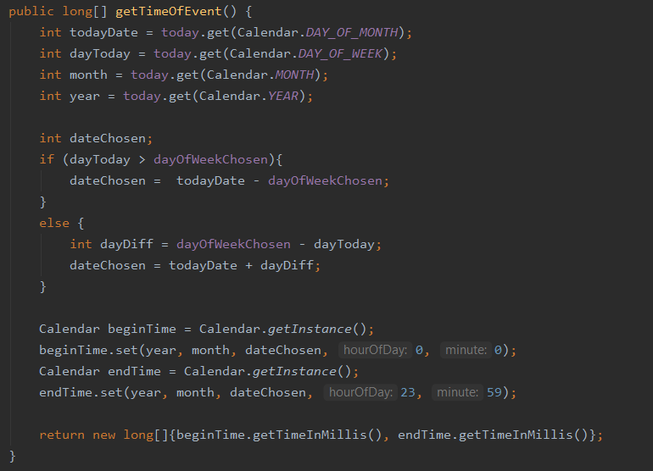
Primary Concepts Used Cont.
This getter is used to retrieve the date of an event.

Slide 18
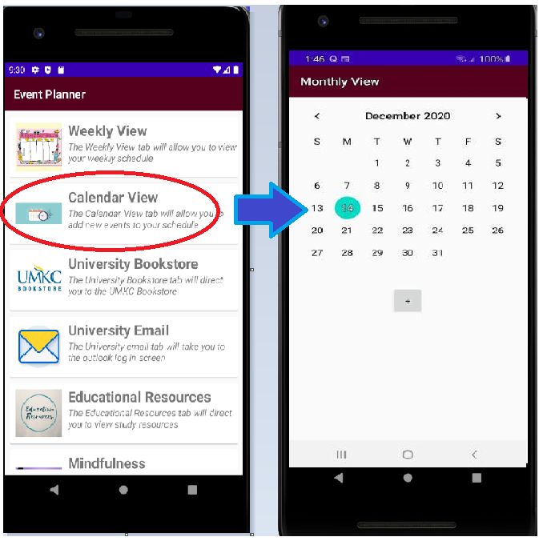
Calendar View Tab
The Calendar View tab will direct the user to a calendar. There, they will be able to select which month they would like to edit and add an upcoming event through this page.

Slide 19
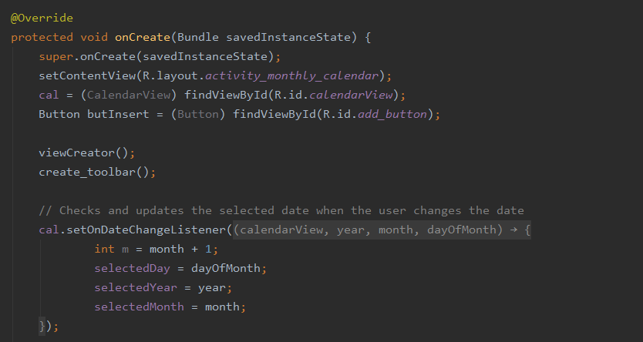
Primary Concepts Used
On the startup of this section the view is created. It then checks the selected date and updates it as necessary.

Slide 20
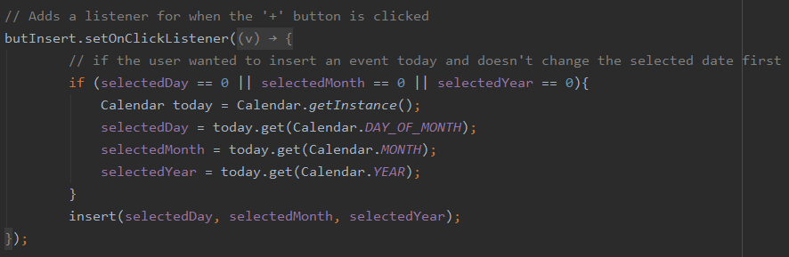
Primary Concepts Used Cont.
This onClickListener will check if the user wishes to insert an event on the given date

Slide 21
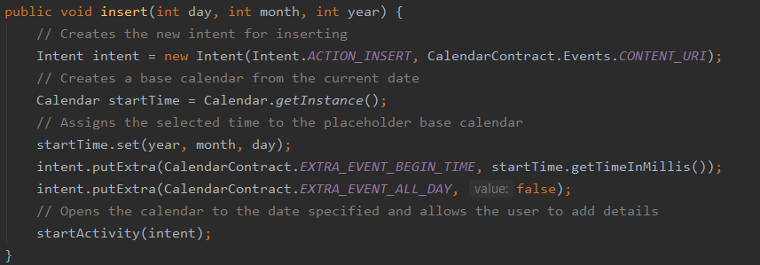
Primary Concepts Used Cont.
This function is then used to insert the event information as desired.

Slide 22
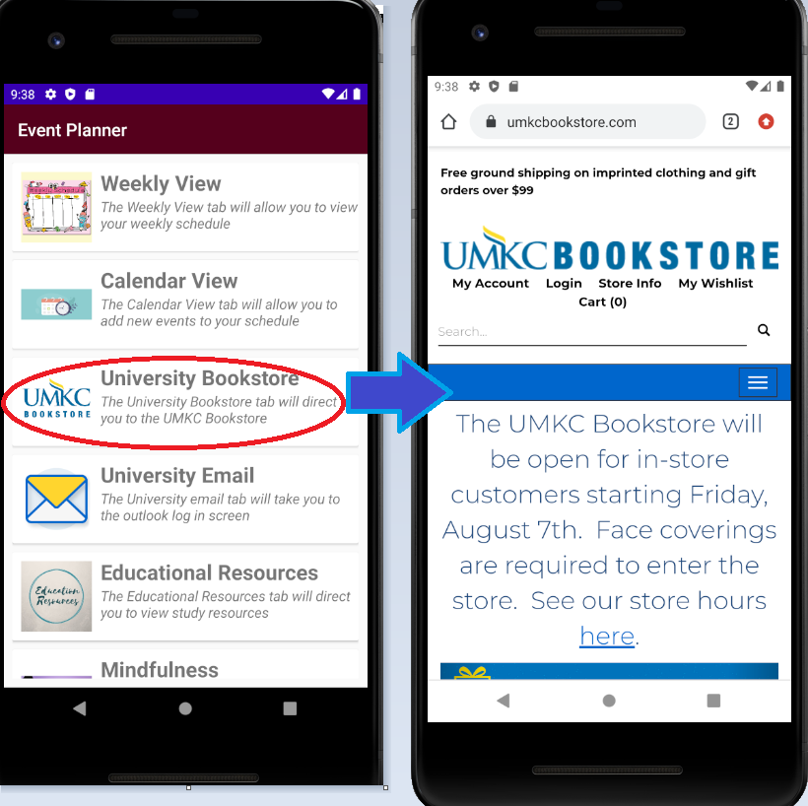
University Bookstore Tab
The University Bookstore will direct the user to the UMKC Bookstore page. They are able to browse for their course materials as desired.

Slide 23
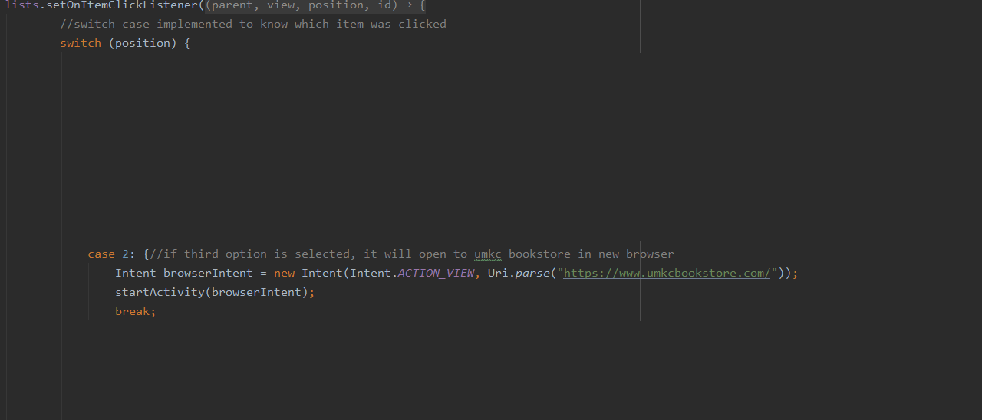
Primary Concepts Used
This requires a simple explicit intent. It will redirect to the umkc bookstore where the user can browse as desired. It is called in a switch statement.

Slide 24
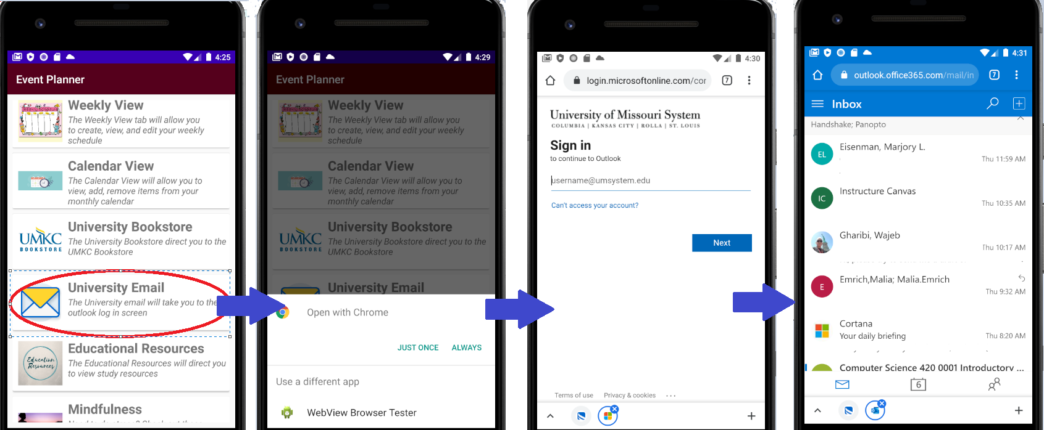
University Email Tab
The University Email will direct the user to the UMKC student email page. They are able to log in and review their emails as needed.

Slide 25
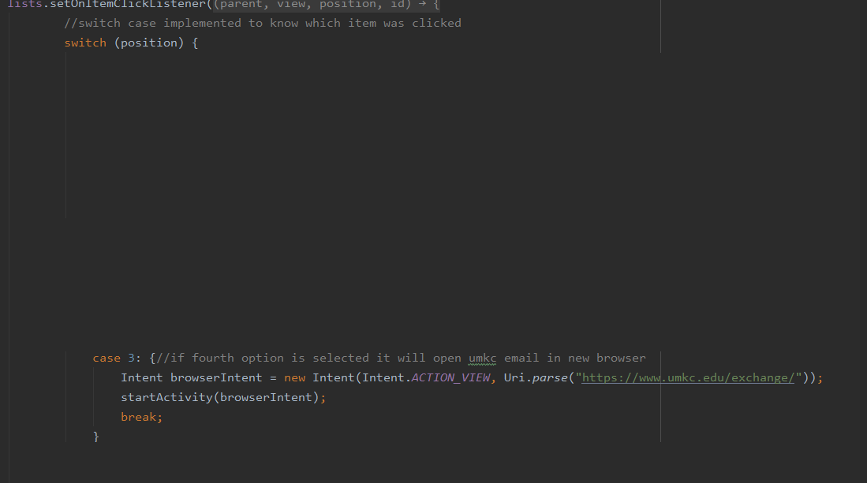
Primary Concepts Used
This requires a simple explicit intent. It will redirect to the umkc email log in, where the user can then input their info. It is called in a switch statement.

Slide 26
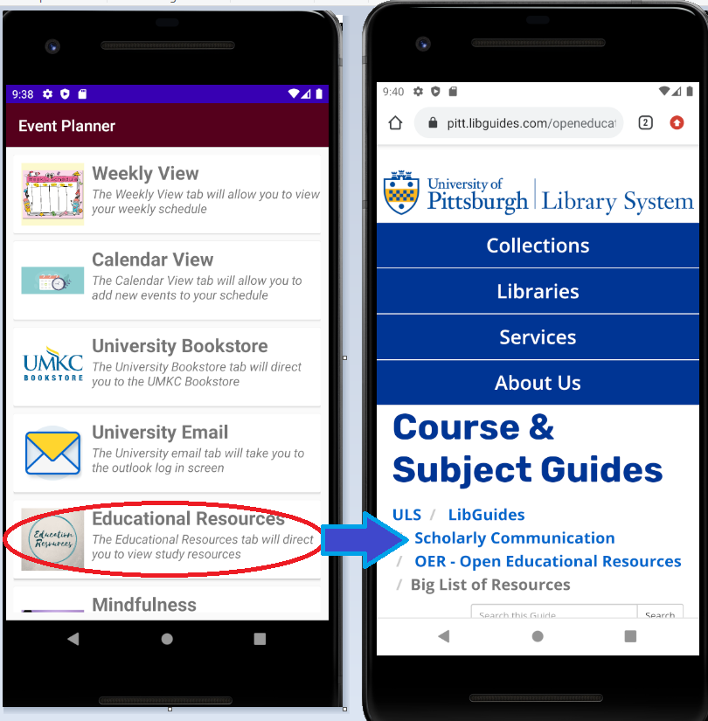
Educational Resources Tab
Educational Resources will direct the user to a page that will allow them to search for course specific study materials and guides.

Slide 27
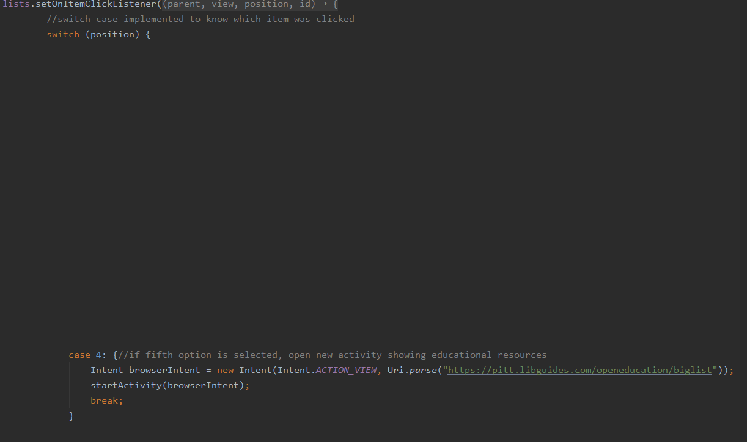
Primary Concepts Used
This requires a simple explicit intent. It will redirect to a website that will allow the user to view study material based off their major. It is called in a switch statement.

Slide 28
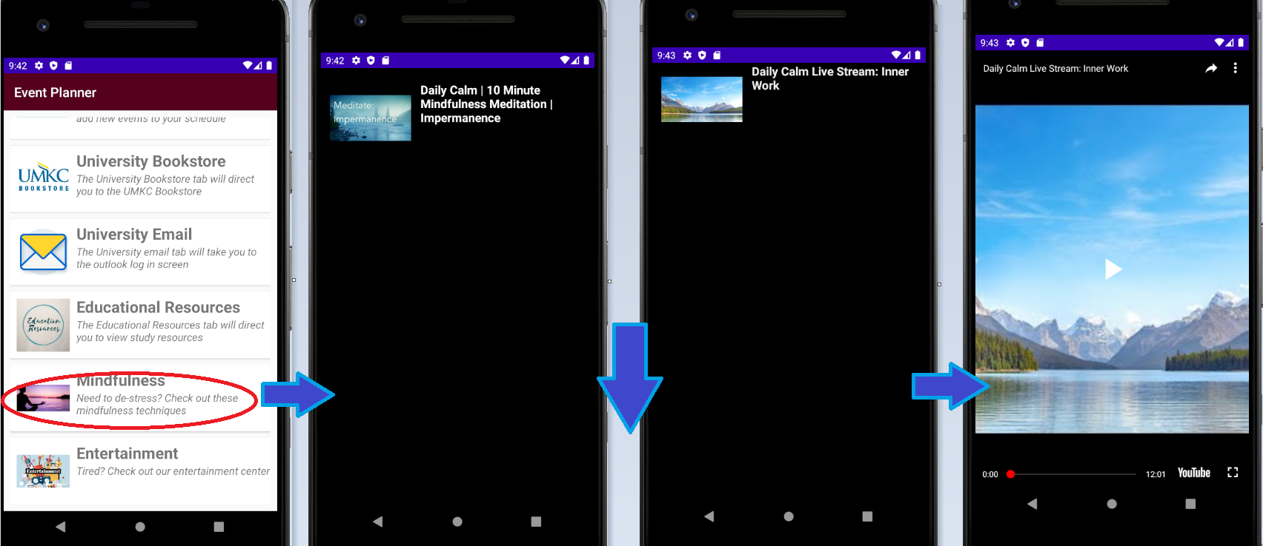
Mindfulness Tab
Mindfulness will direct the user to a list of meditation techniques and videos. The user may scroll through the videos and make a selection. They will then be able to view the videos as desired.

Slide 29
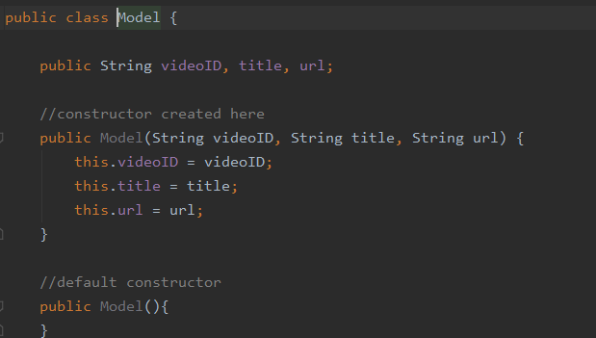
Primary Concepts Used
This class exists to set the ‘Model’ of the youtube video layout. It contains parameterized constructors and getter/setters for the video id, title, and url.

Slide 30
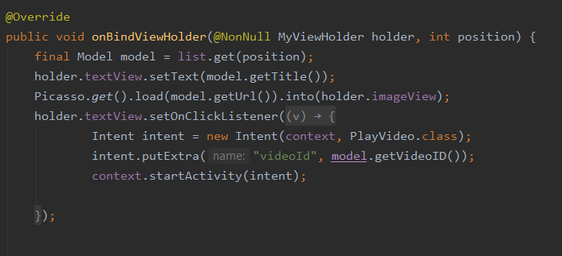
Primary Concepts Used Cont.
An Adapter was used to act as a ‘bridge’ between the Adapter and the data it wishes to access. This was used to bind the data accessed from the youtube API to the model class.

Slide 31
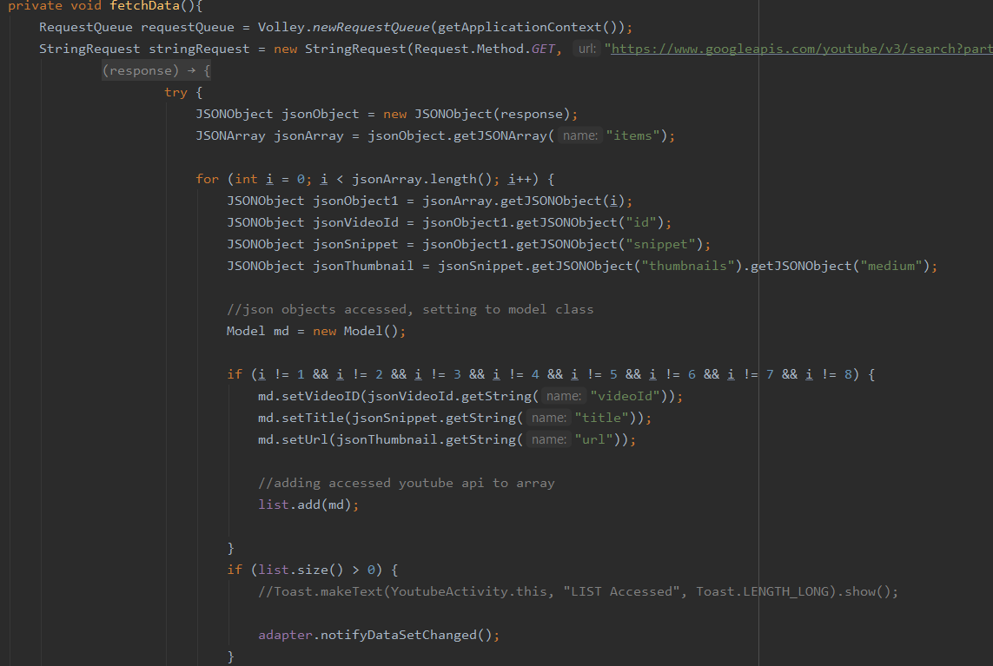
Primary Concepts Used Cont.
This function was created to fetch the data from the youtube api. It breaks down each section and saves the video id, title, and url to the model object. This information is then used in multiple locations, specifically to have the images and titles appear on the screen and allow the video to be viewed.

Slide 32
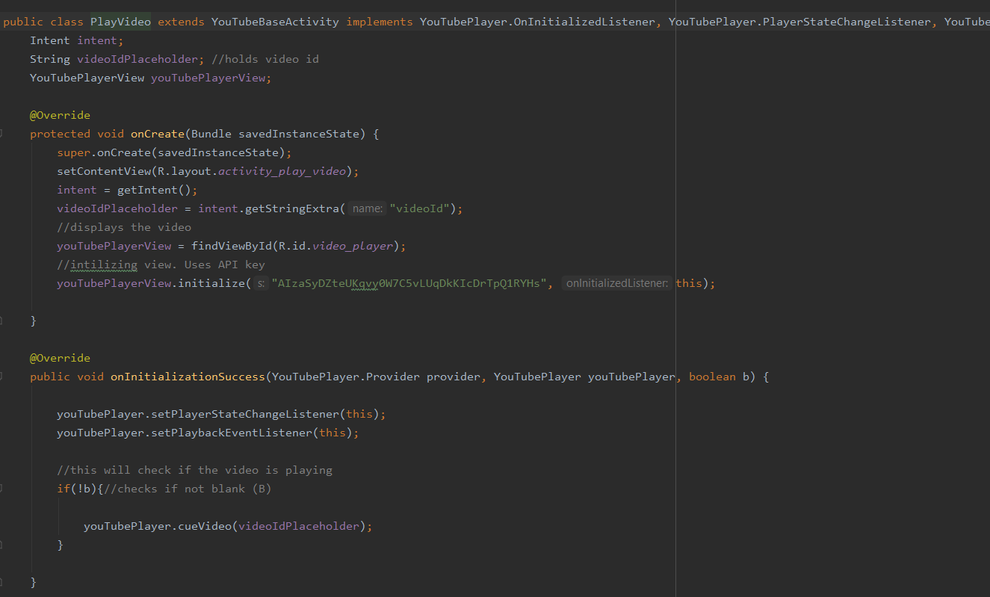
Primary Concepts Used Cont.
This uses the YoutubeBaseActivity . It allows one to directly incorporate YoutubeView into the app so the videos will play when clicked. It requires info retrieved from the fetchData function.

Slide 33
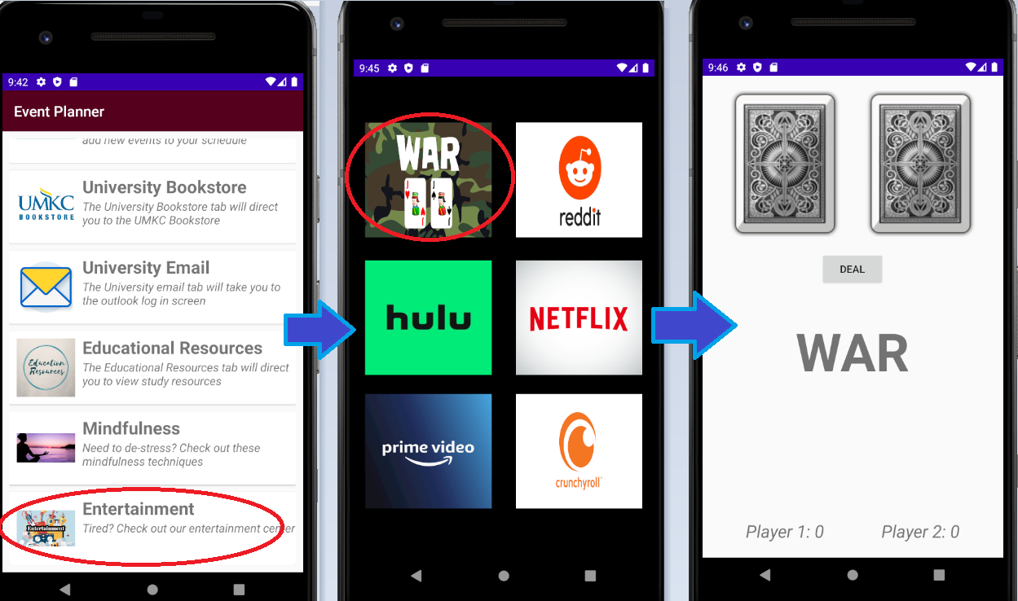
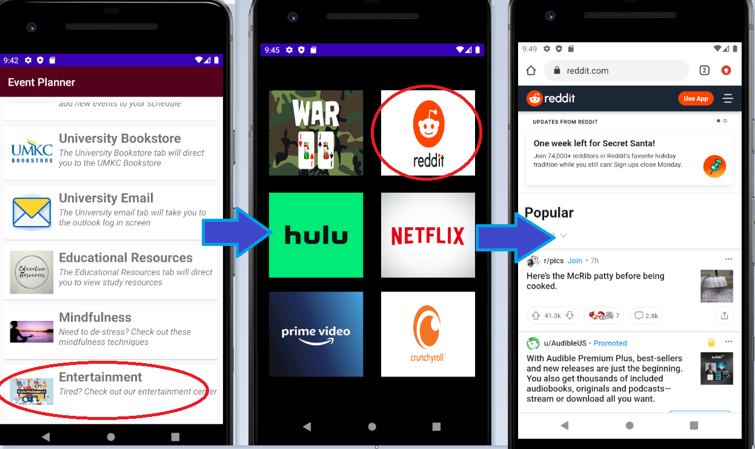
Entertainment Tab
The Entertainment section provides some of the most common streaming services for the user to review. Additionally, they can review one social media service and one on-app game.
Game Service
Social Media Service

Slide 34
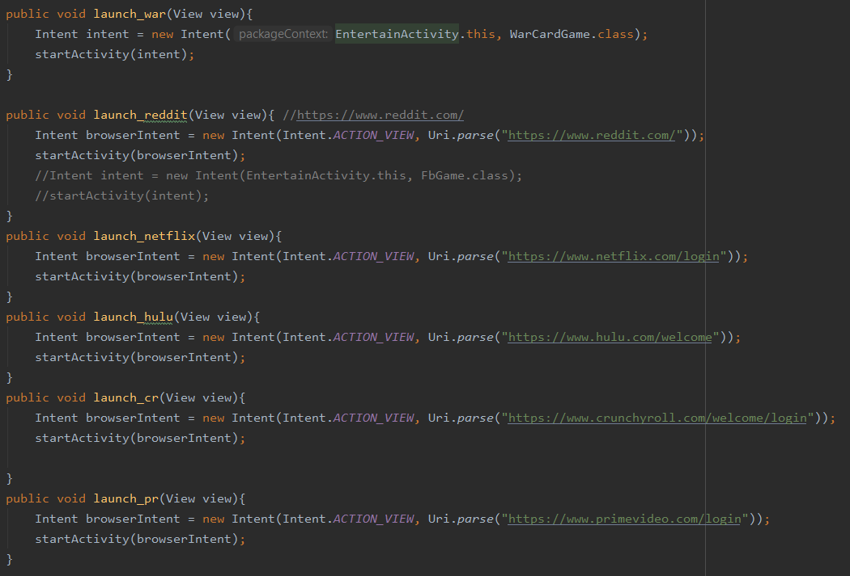
Primary Concepts Used
The game, when clicked, will direct to a new activity as demonstrated here. In that new activity the code for the card game is created.
Note that to access the streaming services and reddit an explicit intent is used. It will redirect to the given links for the user.

Slide 35
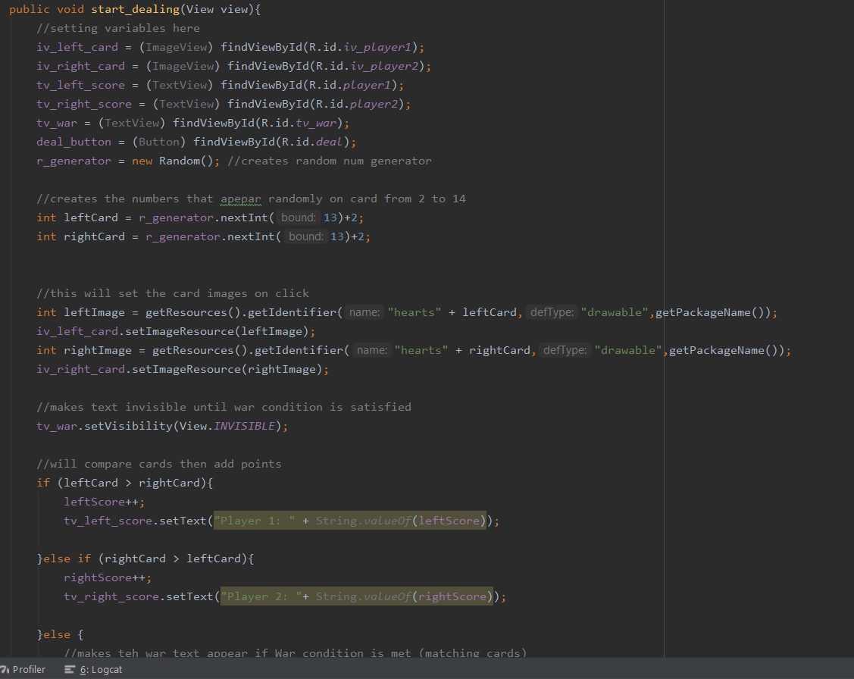
Primary Concepts Used Cont.
This required the creation of a start_dealing function. This was called in the xml file. It will randomly generate a number within a specific range. That number is then concatenated with the string “hearts” so it can call the associated image from the drawables tab on the left.

Slide 36
Future Add-Ons and Improvements
University Specific Info- This app uses UMKC information as standard. To make this application more useful nationwide, it would be beneficial to be able to purchase books specific from that school or use school specific emails.
Better Games- This app currently only has a simple card game. It would be a much more used service if a few more game selections were implemented
Streamlined YouTube service- The app displays a single video at a time while scrolling. Being able to display multiple videos at once would give the application a neater appearance.
Notifications- Currently, this app does not provide any noise or sounds for notifications. This is something that could be added at a later date for a better reminder service
Translations- This application displays all text in English. Considering many languages are spoken in the US, it may be beneficial for the app to offer a language selection choice.
More Study Material- Though the app uses a service that will allow you to find study material based off your major, it would be beneficial to implement more services related to studying including notecards, video and audio recorders.
Notes:
This application only shows the general designs and possibilities. For further enhancement, this application could implement:

